Slide 1
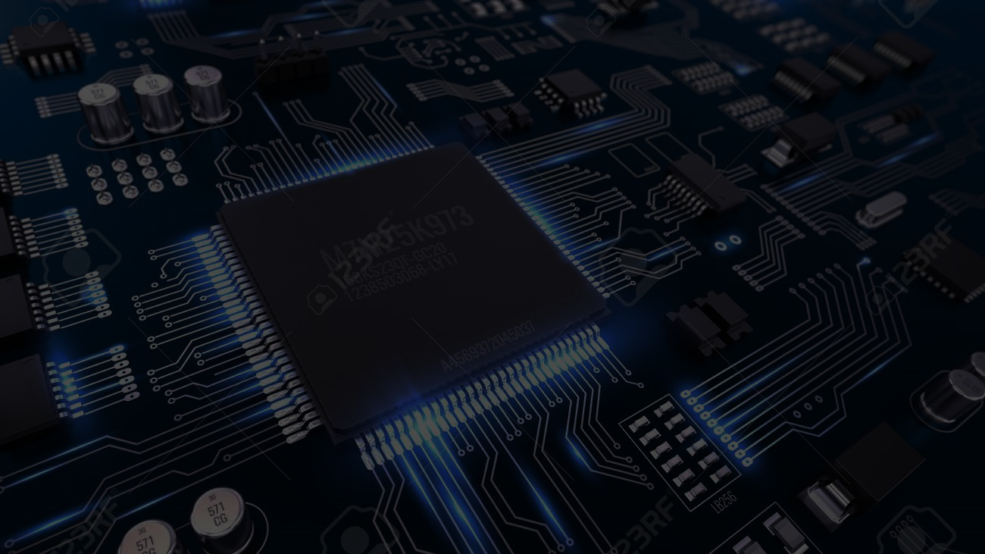







WHAT IS HDD AND SSD ?
HARD DISK DRIVE
COMPARISON
INTRODUCTION
PRESENTED BY
SOLID STATE DRIVE
CONCLUSION
This Photo by Unknown Author is licensed under CC BY-SA

Slide 2
PRESENTED BY:-
Name: Yadav Rohit k. Roll no: 213
Enrollment No:22002170110210 Branch: CE-4B
Name: Shah Viram J. Roll no: 215
Enrollment No:22002170110172 Branch: CE-4B
Name: Patel Darshil M. Roll no: 226
Enrollment No:22002170110109 Branch: CE-4B
Name: Nandanvar Nisarg R. Roll no: 232
Enrollment No:22002170210053 Branch: IT-4B
Name: Chauhan Ajay J. Roll no: 240
Enrollment No:22002170210008 Branch: IT-4B

Slide 3
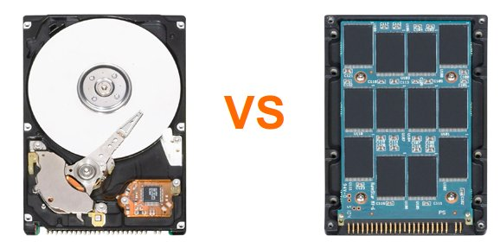
INTRODUCTION
Data storage continues to be a battle between HDD (Hard Disk Drive) and the SSD (Solid State Drive).
HDDs and SSDs used for storage inside desktops and laptops.
There's a place for storage drives inside servers, external storage boxes, and NAS devices.

Slide 4
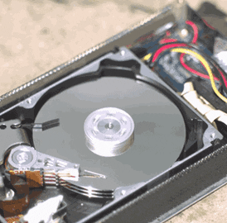
HARD DISK DRIVE
A hard disk drive (HDD) is a non-volatile storage device that stores and retrieves digital data using magnetic storage technology.
While not as fast as SSDs
HDDs are much cheaper and come in far bigger sizes, up to 22TB.

Slide 5
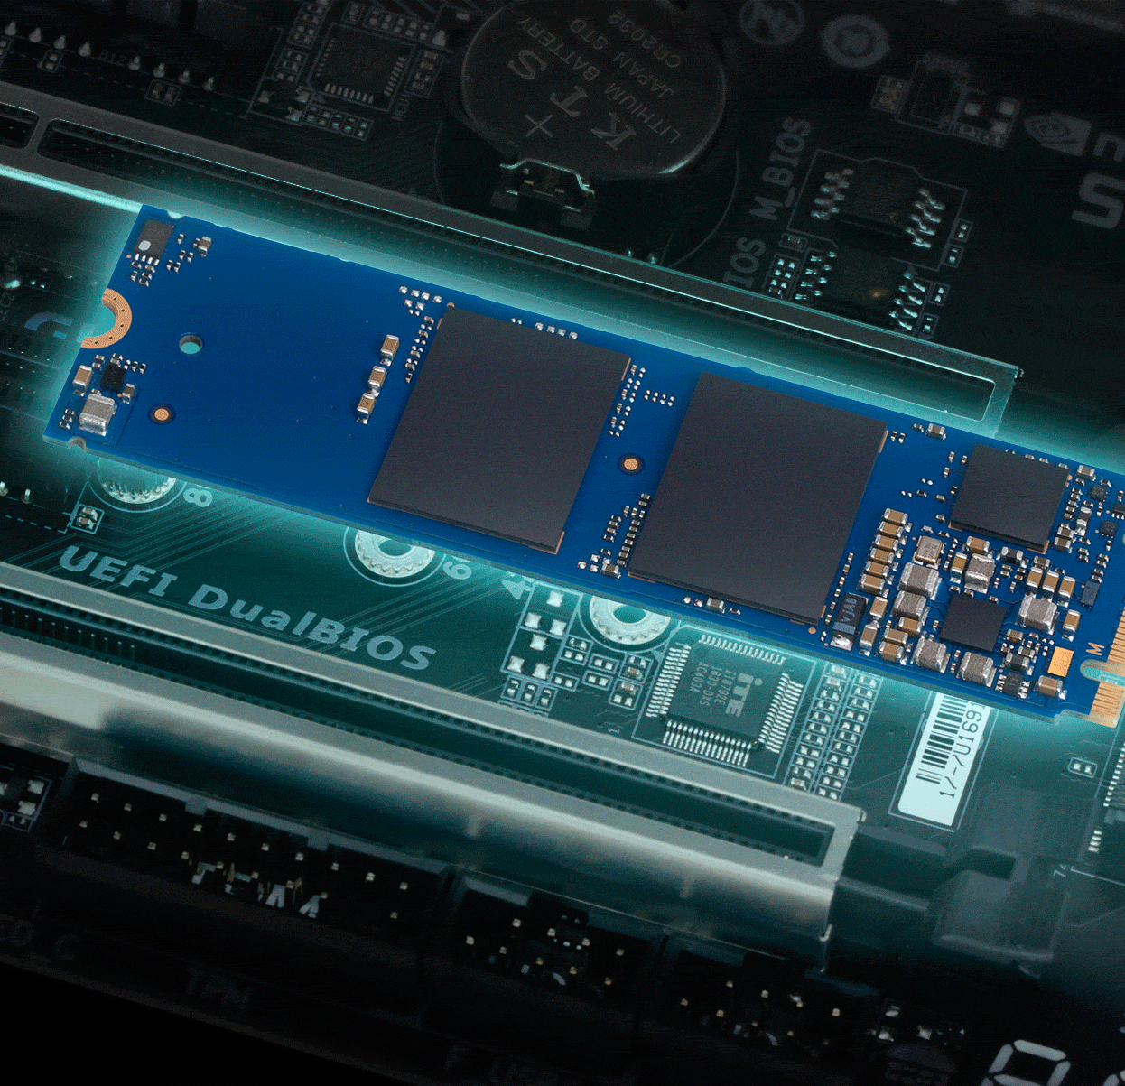
SOLID STATE DRIVE
A solid-state drive (SSD) is a non-volatile storage device that stores and retrieves digital data using NAND-based flash memory technology.
These chips offer fast read and write speeds, making SSDs a fast data storage medium.
There are no moving parts in an SSD, which means that they are silent when in use and are not susceptible to damage from vibrations and impacts.

Slide 6


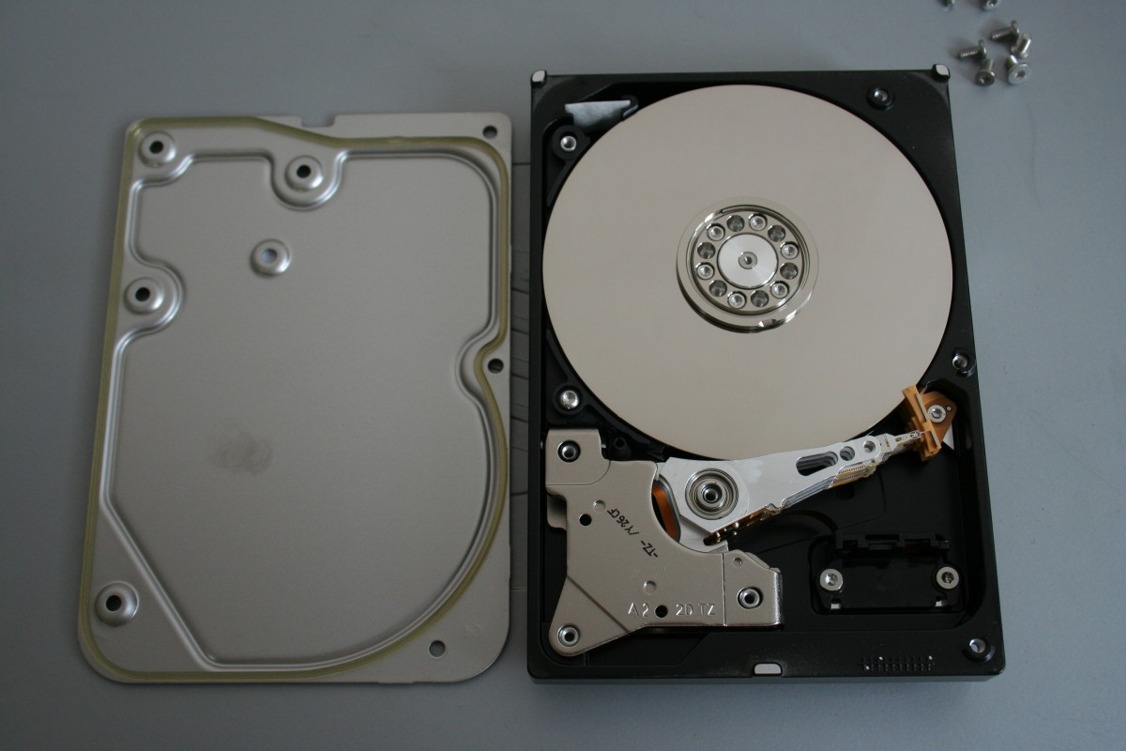
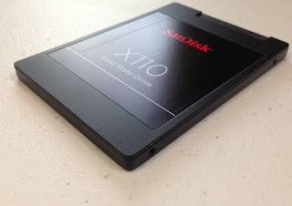
COMPARISON
HDD
SSD
Max Capacity: 22TB
Cost Per GB: 3 to 4 Rupees
Read/Write Speed: 250MB/S(At 7200 RPM)
Noise Output: Low Level Ticking
Power Consumption: 8W
Lifespan: 3-5 Years
Max Capacity: 4TB
Cost Per GB: 7 to 9 Rupees
Read/Write Speed: 3000-7000 MB/S
Noise Output: Silient
Power Consumption: 2W
Lifespan: 8-12 Years

Slide 7

CONCLUSION
SSD is better than HDD Why??
SSDs are much faster than HDDs
SSDs are more durable than HDDs because they have no moving parts that can break.
SSDs use less power than HDDs because they don't have to spin a disk to access data.
SSDs are much smaller and lighter than HDDs

Slide 8

This Photo by Unknown Author is licensed under CC BY-SA-NC

